Slide 1
National Conference on
Advances in Science Engineering & Technology
7th NOV 2025
“ECHOPULSE : An AI-powered Voice Automation System for Real-Time Outbound Communication”
by
Anagha Deshpande --1SG23IS007
Harshitha K --1SG23IS039
Kavya C --1SG23IS048
Kritika Manani --1SG23IS051
Guided by: Prof. Vasanthalakshmi M
(Asst prof, ISE dept)
Sapthagiri College of Engineering
DEPARTMENT OF ISE

Slide 2
Contents
Abstract
Introduction
Problem Statement
Literature review
Existing v/s proposed system
Objectives
Block Diagram
Implementation
Results & Discussions
Future scope
Conclusions
References

Slide 3
Abstract
Echopulse is an AI-driven voice automation system for real-time outbound calls. It delivers natural, human-like speech using prompt-based synthesis, enabling dynamic, personalized communication at scale. With expressive AI voices and robust infrastructure, Echopulse ensures timely, cost-effective updates across industries.

Slide 4
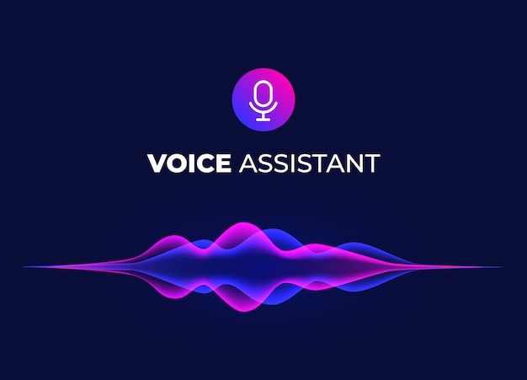
Introduction
Echopulse is a mainly a combination of two softwares
Eleven Labs offers advanced voice synthesis, while Twilio provides scalable telephony APIs.
This project bridges both platforms to create a seamless outbound calling experience for tech updates.
Fulfilling the rise of conversational AI

Slide 5
Problem statement
Businesses need to communicate with customers in real time, but traditional outbound call systems are limited. They often lack personalization, and can’t handle high volumes efficiently. Delivering natural, intelligent, and cost-effective voice communication—quickly and across large audiences—is a major challenge across industries.

Slide 6
Literature Review
TITLE | AUTHOR | YEAR OF PUBLICATION | OBSERVATION | LIMITATION
User Interaction Patterns and Breakdowns in Conversing with LLM-Powered Voice Assistants | Amama Mahmood, Junxiang Wang | 2023 | Analyzes how users interact with LLM-based voice assistants and identifies breakdowns in communication | Does not provide technical solutions or frameworks to address the identified interaction issues.
Empathetic Intelligence: LLM-Based Conversational AI Voice Agent | Vipul Bhatia, Priyam Sekra, Soni Sweta | 2024 | Introduces an empathy-driven voice assistant architecture using LLMs with sentiment analysis and response generation. | Focuses mainly on emotional modeling; limited exploration of large-scale deployment and telephony integration.
Evolution of Voice Automation | Barty-Bart | 2024 | Traces the progress of voice automation from concatenative and parametric synthesis to neural TTS models. | Lacks focus on integration with conversational AI and real-time communication systems.

Slide 7
Existing system and its limitation
The existing system focused mainly on setting up API keys, importing Twilio numbers, and configuring voice routing using ElevenLabs TTS.
It used Twilio ConversationRelay configuration to connect ElevenLabs voices through Node.js and was largely dependent on open-source JavaScript repositories.

Slide 8
While functional, this setup had several limitations, they are:
It was technically complex, requiring prior knowledge of API integration and server configuration.
The interaction flow was rigid and predefined, offering little room for personalization or adaptive responses.
Moreover, it lacked emotional tone and contextual awareness, making the communication sound robotic and less engaging.
The system also offered limited educational or research value, as it was built mainly for demonstration rather than flexible, replicable use.

Slide 9
Proposed System
Echopulse addresses these challenges by introducing a custom Python-based outbound voice agent that delivers tech updates in a natural, conversational manner.
Built using Cursor IDE and deployed via MCP servers, it replaces ConversationRelay with a direct prompt-based agent, eliminating the need for complex Twilio relay configurations.
The system incorporates agent personality traits such as friendliness and confidence, making the voice output more human-like and engaging.

Slide 10
In addition, Echopulse integrates academic onboarding commands and terminal-based automation, making setup and replication much easier for students and developers.
By enhancing usability, personalization, and emotional tone, Echopulse transforms a static automation setup into an educational, customizable, and user-friendly voice automation platform that overcomes the rigidity, technical dependency, and lack of interaction found in the existing system.

Slide 11
Objectives
To develop an AI-based voice agent that communicates through phone calls.
To integrate ElevenLabs for realistic voice generation.
To use Twilio API for making and managing automated calls.
To connect all APIs using MCP in Cursor IDE for smooth operation.
To deliver accurate and real-time information through AI-powered voice interaction.

Slide 12

Block Diagrams

Slide 13
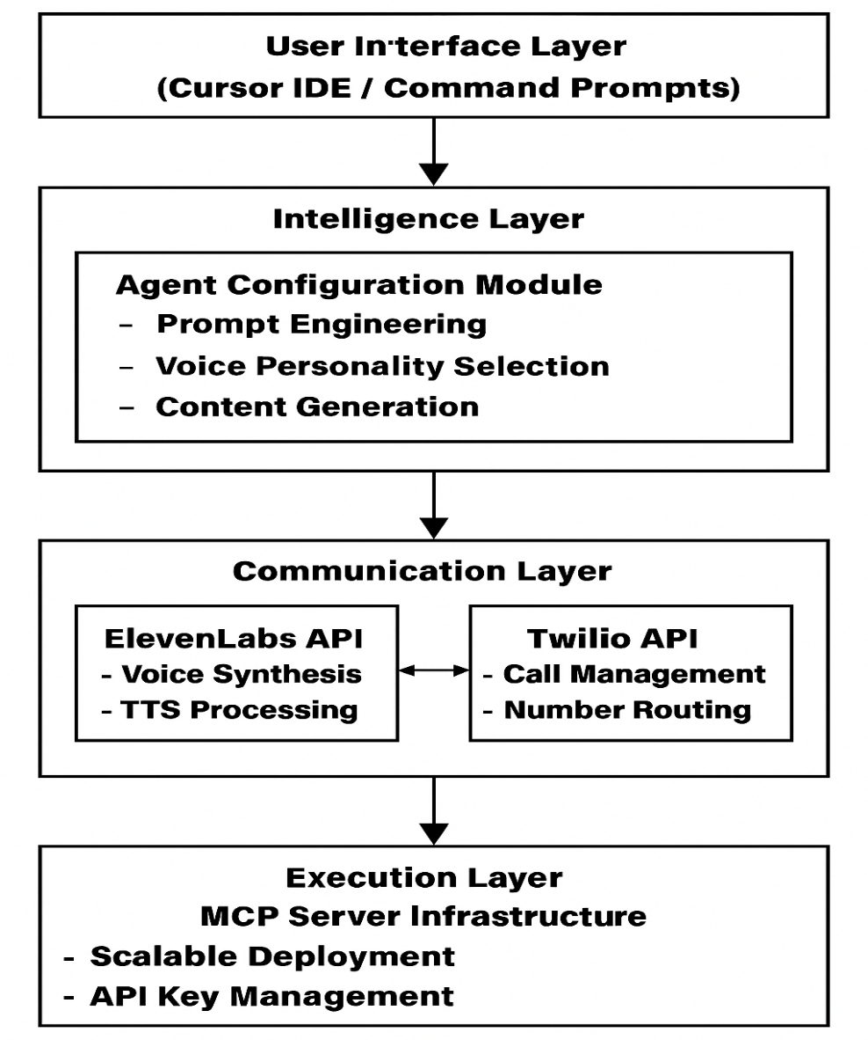
Working of echopulse

Slide 14
Implementation
The implementation of ECHOPULSE involved systematic execution of the designed architecture through careful integration of ElevenLabs, Twilio, and MCP server infrastructure.
This section details the practical steps taken to bring the system to life.

Slide 15
Accounts Created: ElevenLabs and Twilio accounts were set up for API access and call functionality.
API Key Generation: Unrestricted ElevenLabs API key was created and stored securely.
Twilio Configurator:
Verified phone number via OTP
Purchased trial number
Configured voice URL: https://api.us.elevenlabs.io/twilio/inbound_call
Integration:
Twilio number imported into ElevenLabs
Twilio Account SID and Auth Token linked

Slide 16
MCP Server Setup:
Installed via Cursor IDE terminal
pip install elevenlabs-mcp python -m elevenlabs_mcp --api-key=<your_api_key>
Agent Creation:
Prompt: create an agent that makes an outbound call to update someone about recent tech news
Voice: Female, friendly, confident
Function: Deliver updates on AI, programming, cybersecurity
Call Execution:
Agent initiated outbound call via Twilio
Call connected to verified number
Agent delivered real-time voice message

Slide 17
Results
The AI agent successfully made real-time phone calls using Twilio API.
ElevenLabs generated clear, human-like voice responses.
The system delivered accurate information during calls with minimal delay.
Integration through MCP in Cursor IDE ensured smooth communication between API’s .

Slide 18
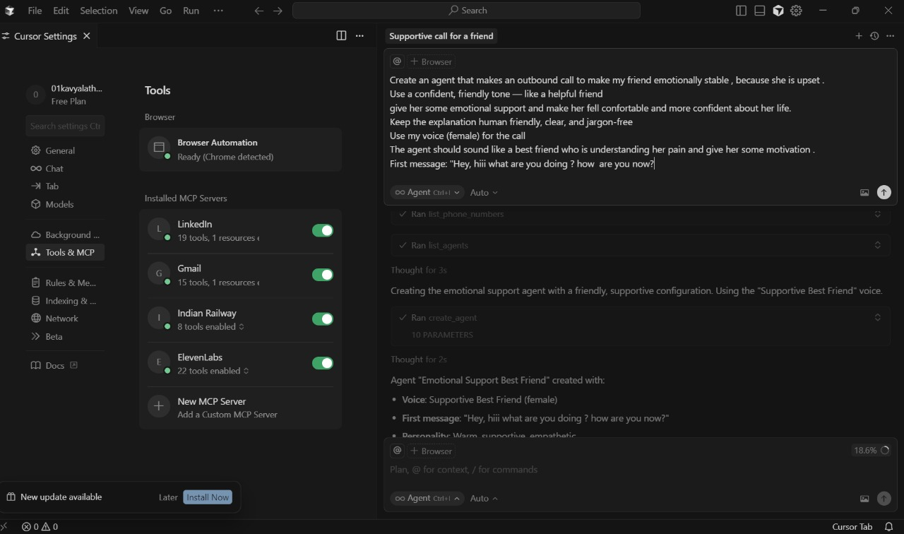

PROMPT given in CURSOR IDE
OUTPUT

Slide 19
Future Scope
Enhanced Conversational Capabilities
Future development will focus on more sophisticated natural language understanding, enabling ECHOPULSE to handle complex, multi-turn conversations with greater contextual awareness and adaptive behavior.
Self-learning system
Implementing reinforcement learning techniques will allow ECHOPULSE to continuously improve its conversation strategies based on recipient feedback and outcome data.

Slide 20
Conclusions
Echopulse brings together AI voice synthesis and telephony automation to create a smart voice agent that makes real-time phone calls. It uses ElevenLabs for lifelike speech, Twilio for seamless call handling, and MCP integration via Cursor IDE to ensure smooth operation. The result is clear, human-like communication that automates information delivery and enhances user interaction. Echopulse stands out as an innovative and efficient solution for real-time voice automation.

Slide 21
References
ElevenLabs. (2024). AI Voice Generation Platform. https://elevenlabs.io4.
Twilio. (2024). Programmable Voice API Documentation. https://www.twilio.com/voice5.
Microsoft. (2024). Model Context Protocol (MCP) for AI Integration. https://microsoft.github.io/mcp
Jurafsky, D., & Martin, J. H. (2023). Speech and Language Processing (3rd ed.). Pearson Education.

Slide 22
THANK YOU

